Slide 1
Reinforcement Learning (RL) in Time Series Forecasting

Slide 2
Objective
Develop a robust and reliable forecasting solution by accurately predicting demand fluctuations in a volatile market
Traditional time series forecasting methods have proven inadequate in capturing the patterns of our data, hence required the exploration of advanced techniques
Proposed Solution
Leveraging a hybrid approach combining LSTM feature extraction with Proximal Policy Optimization (PPO) agent-based reinforcement learning model
Expected Outcome
Adaptable model with capability to learn complex patterns and enhance forecasting accuracy

Slide 3
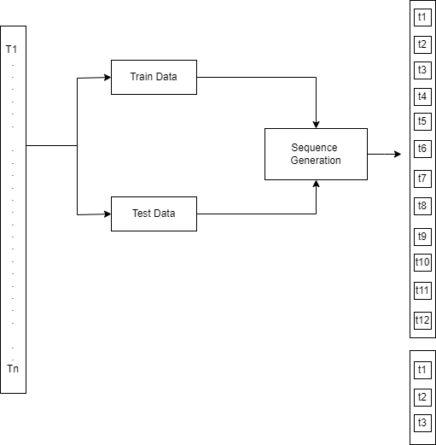
Data Preparation
Dataset : we took open source dataset https://www.kaggle.com/code/tom111989/forecasting-austrian-beer-production-sarima/data (which is univariate and small-medium size (~500 rows) of univariate TS data)
Split Data: Segment the dataset into training and testing subsets, typically employing a ratio like 80% for training and 20% for testing.
Time Step-based Sequences: Create train and test sequences based on time steps. For both training and testing sets, generate sequences with a length of 12-time steps (for training) and 3-time steps (for testing). These time step-based sequence lengths ensure that each sequence captures a specific temporal pattern in the data.
**These sequence lengths can be adjusted based on the time frames in the data set

Slide 4
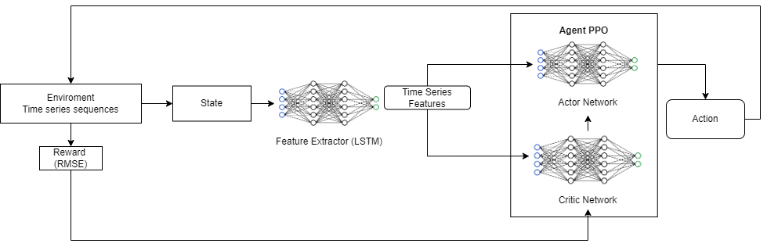
Model Architecture

Slide 5
Reward Functions
Negative RMSE – since we based our reward function on assumption that lesser the difference in real time o/p from policy with actual test values higher the return we designed a negative rmse reward where we are penalizing the system (negatively regarding) based on rmse value of test and actual prediction per step.
Penalized RMSE – we further enhanced this negative RMSE reward with addl. penalties based on rmse scale difference between policy output and actual value per step, for example increased addl penalties added if rmse values exceeds range of 0.25,0.5 and 0.75 in that order

Slide 6
Model Training & Evaluation
Model Number | Feature Extractor | Loss Function | Reward Function | RMSE | MAE
1 | RL-LSTM |  | -RMSE | 0.09 | 0.07
3 | RL - LSTM |  | -Penalized RMSE | 0.10 | 0.08
4 | DL - LSTM | RMSE |  | 0.10 | 0.09
5 | Sarimax |  |  | 11.2 | 9.7

Slide 7
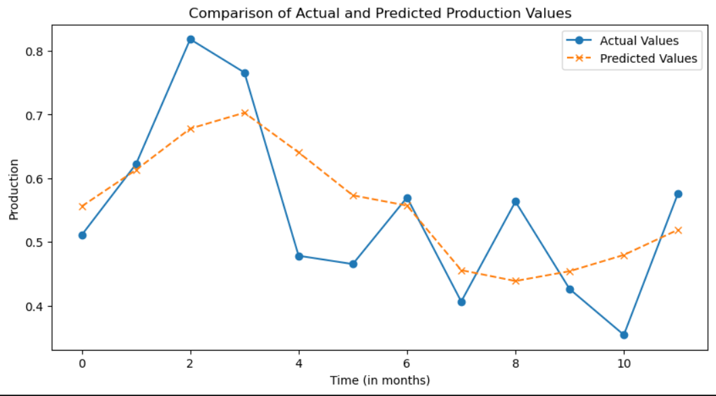
Model 1 (RL LSTM & -RMSE) Results

Slide 8
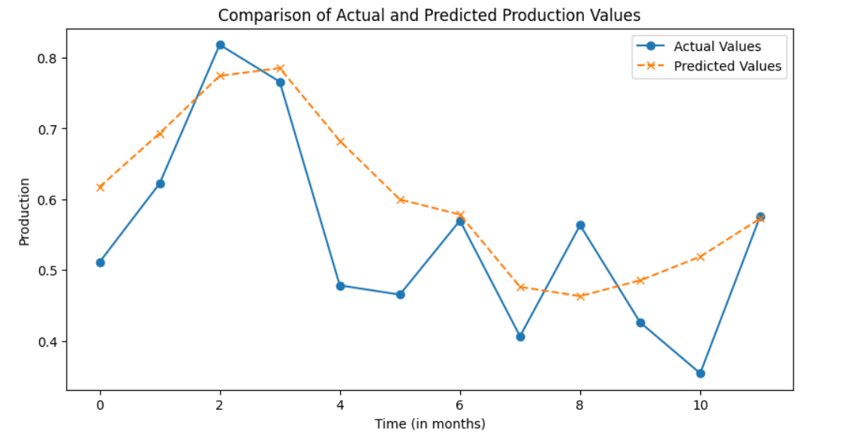
Model 2 (RL LSTM & -Penalized RMSE) Results

Slide 9
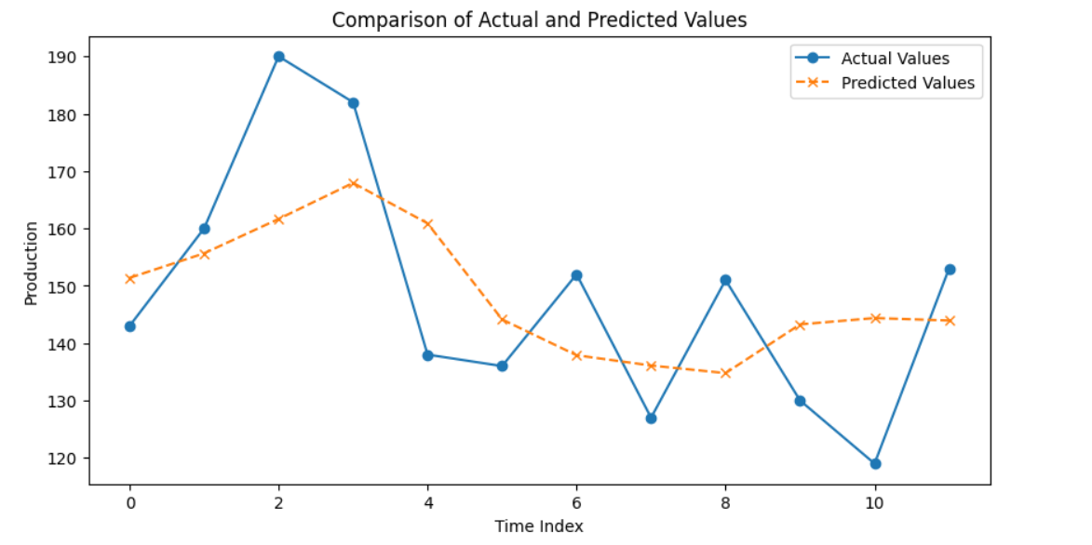
Model 3 (DL LSTM & -Loss RMSE) Results

Slide 10
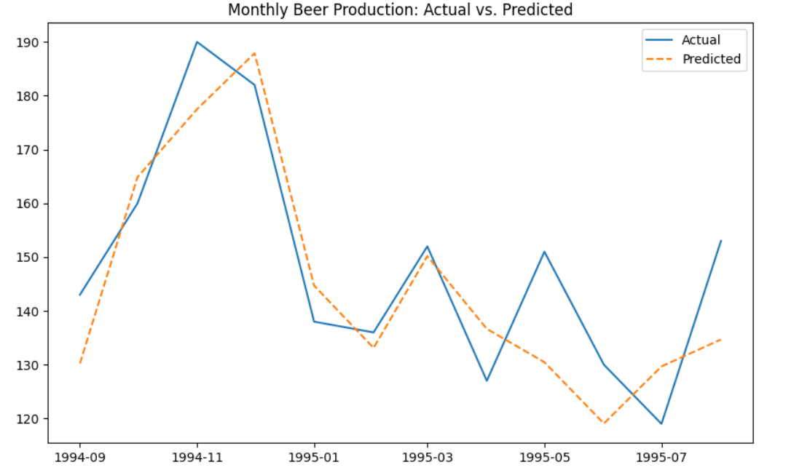
Model 4 (Sarimax) Results

Slide 11
Conclusions and next steps
From the graphs and evaluation metrices we realized that RL with penalized rewards is doing better than it’s LSTM counterpart.However Sarimax is performing best
The analysis leads to conclusion that since we have better control with reward structuring in RL and due to RL’s adaptive nature (ppo/ddpg) it is better option to try in case of medium to large datasets given the fact that it take 10^5 iterations to converge than DL
On the other hand we can not deny that traditional statistical models are able to outperform advanced techniques in certin cases
Next plan is to try on real time datasets (more recent ) where data irregularities are present . The advantage is by studying the irregularities we can formulate reward function that penalizes accordingly rather than calculating continuous loss (as in DL) or statistical measures in ML and get optimum output

Slide 12
Design thinking
In order to create a robust architecture for timeseries analysis (univariate/multivariate) for any size of data , the approach we can take in future is amalgamating RL policy with ensemble of different algorithms (starting from Sarimax ,Xgboost regressor to Nbeats/LSTM)
This will ensure we get best of ML/DL as well as RL
During inference in Online env the policy will choose best algorithm to apply on a given state to generate optimum action.

